Slide 1
Dynamic Algorithms in Geometry
Wolfgang Mulzer

Slide 2
A Classic Result
Goal:
a fully dynamic data structure to support a lower envelope of lines
Operations:
insert:
insert a new line
delete:
delete a line
vertical ray shooting:
which line appears on the lower envelope at a given x-coordinate?

Slide 3
Dynamic Planar Lower Envelopes
Approach by Overmars and van Leeuwen, 1981
Idea:
Maintain a balanced tree on the lines, sorted by slope
Root stores complete lower envelope
Each node stores partial lower envelope for subtree that is obscured by parent envelope
On update: split/merge envelopes to maintain this information

Slide 4
Dynamic Planar Lower Envelopes

Slide 5
Dynamic Planar Lower Envelopes

Slide 6
Dynamic Planar Lower Envelopes
Key challenge:
find the intersection of two lower envelopes
Idea:
simultaneous binary search in both envelopes
all blue lines are smaller than all red lines
the pivot blue point is u.p and the pivot red point is v.p
IV
ℓ
III
q
m
separating slope
v.p
I
II
u.p
L
R

Slide 7
Dynamic Planar Lower Envelopes
Key challenge:
find the intersection of two lower envelopes
Idea:
simultaneous binary search in both envelopes
Case 1: u.p lies in Region I.
the blue envelope to the left of u.p can be deleted
IV
ℓ
III
q
m
separating slope
v.p
I
II
u.p
L
R

Slide 8
Dynamic Planar Lower Envelopes
Key challenge:
find the intersection of two lower envelopes
Idea:
simultaneous binary search in both envelopes
Case 2: u.p lies in Region II.
the red envelope to the left of v.p can be deleted
IV III
ℓ
v.p
separating slope
m
q
I
II
u.p
L
R

Slide 9
Dynamic Planar Lower Envelopes
Key challenge:
find the intersection of two lower envelopes
Idea:
simultaneous binary search in both envelopes
And so on. Can always rule out a constant fraction of one envelope
IV III
ℓ
v.p
separating slope
m
q
I
II
u.p
L
R

Slide 10
Dynamic Planar Lower Envelopes
Key challenge:
find the intersection of two lower envelopes
Idea:
simultaneous binary search in both envelopes
And so on. Can always rule out a constant fraction of one envelope
Running time:
O(log n) for finding intersection
O(log² n) per operation
Since then:
Many improvements
Chan 2001: O(log^{1+ε} n)
amortized, implicit representation
Brodal Jacob 2000: O(log n loglog n)
Brodal Jacob 2001: O(log n)

Slide 11
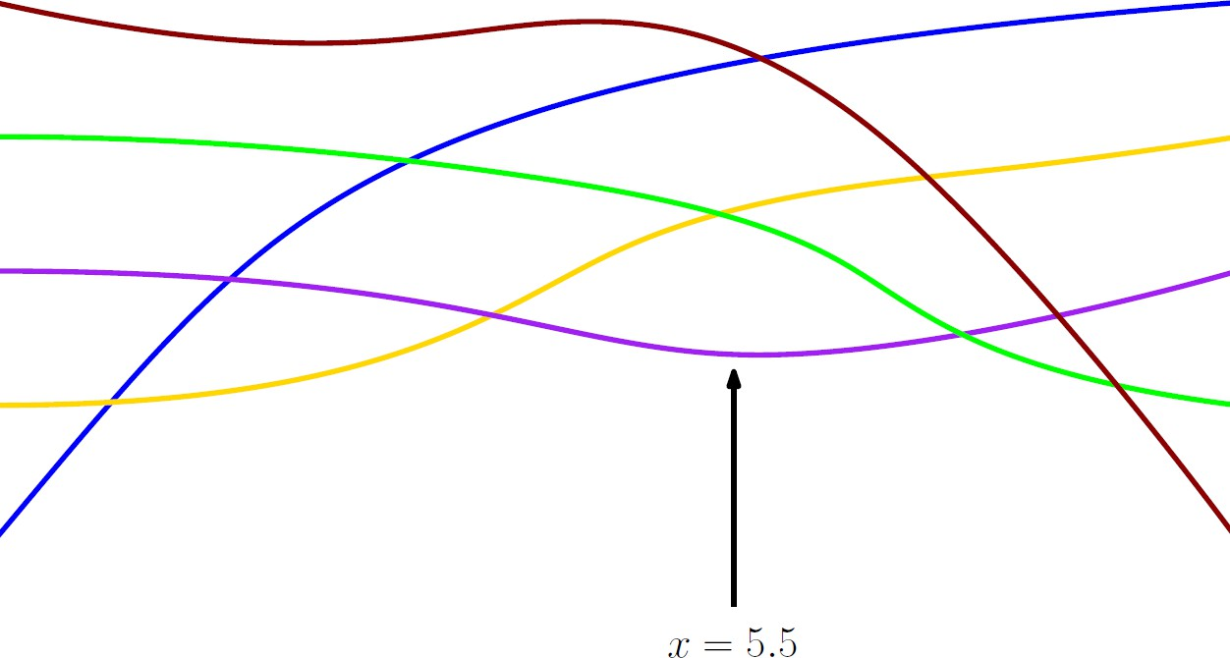
Dynamic Planar Lower Envelopes of Pseudolines
Now: same task, for pseudolines
arrangement of pseudolines:
set of curves where every pair crosses exactly once
can order pseudolines by intersection with x = -∞
every pseudoline appears at most once on lower envelope, in this order
OvL applies!

Slide 12
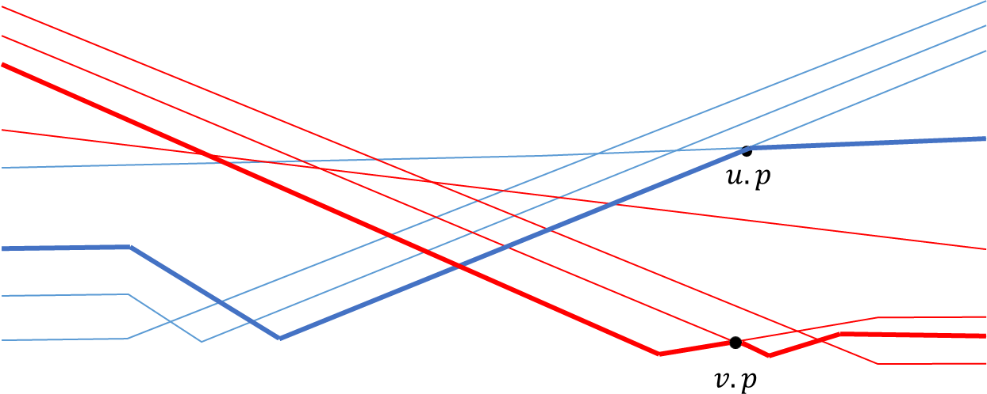
Dynamic Planar Lower Envelopes of Pseudolines
Key challenge:
find the intersection of two lower envelopes
Idea:
simultaneous binary search in both envelopes
Problem:
for pseudolines, local information is not always sufficient
Case 1: u.p is above v.L, we can cut
Case 2 (analogous): v.p is above u.L, we can cut

Slide 13
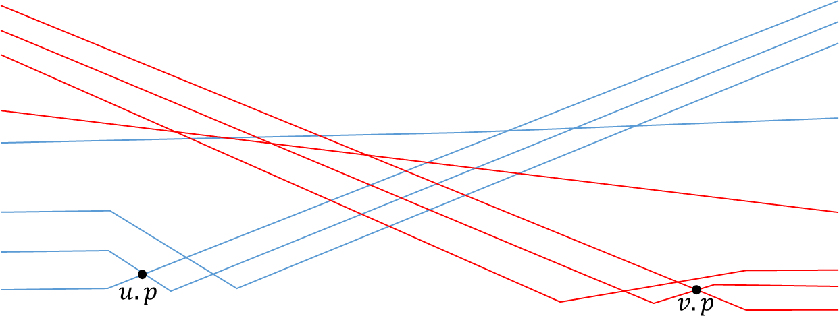
Dynamic Planar Lower Envelopes of Pseudolines
Key challenge:
find the intersection of two lower envelopes
Idea:
simultaneous binary search in both envelopes
Problem:
for pseudolines, local information is not always sufficient
Case 3: each pivot point is below the pivot envelope of the other
This is a problem!

Slide 14
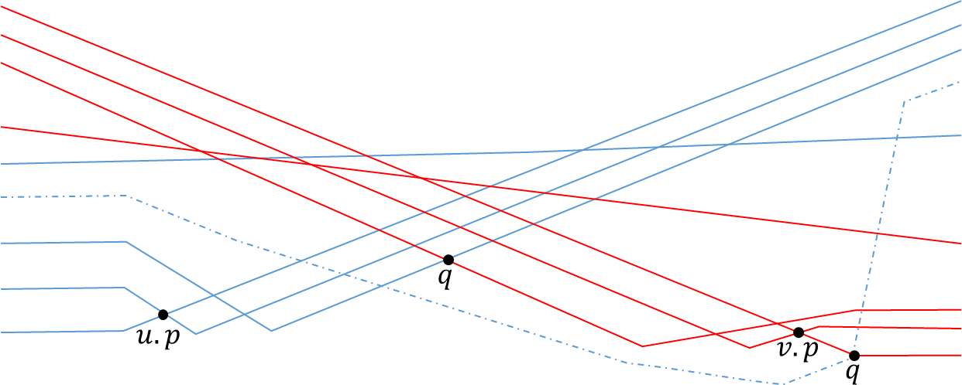
Dynamic Planar Lower Envelopes of Pseudolines
Key challenge:
find the intersection of two lower envelopes
Idea:
simultaneous binary search in both envelopes
Problem:
for pseudolines, local information is not always sufficient
Case 3: each pivot point is below the pivot envelope of the other
This is a problem!

Slide 15
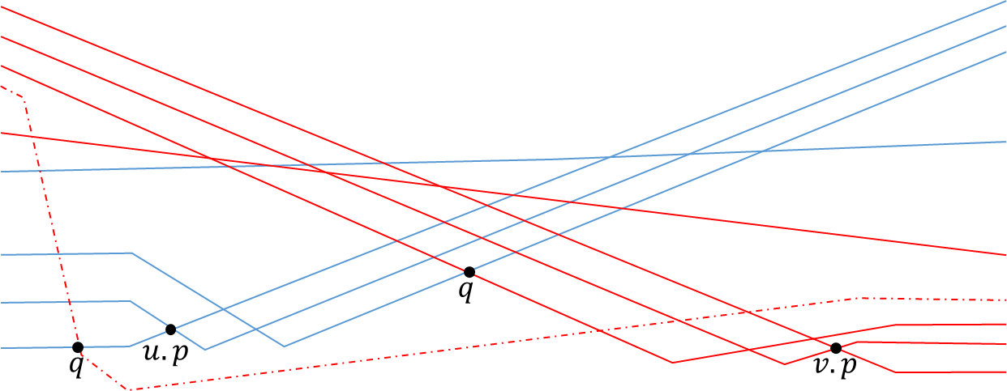
Dynamic Planar Lower Envelopes of Pseudolines
Key challenge:
find the intersection of two lower envelopes
Idea:
simultaneous binary search in both envelopes
Problem:
for pseudolines, local information is not always sufficient
Case 3: each pivot point is below the pivot envelope of the other
This is a problem!

Slide 16
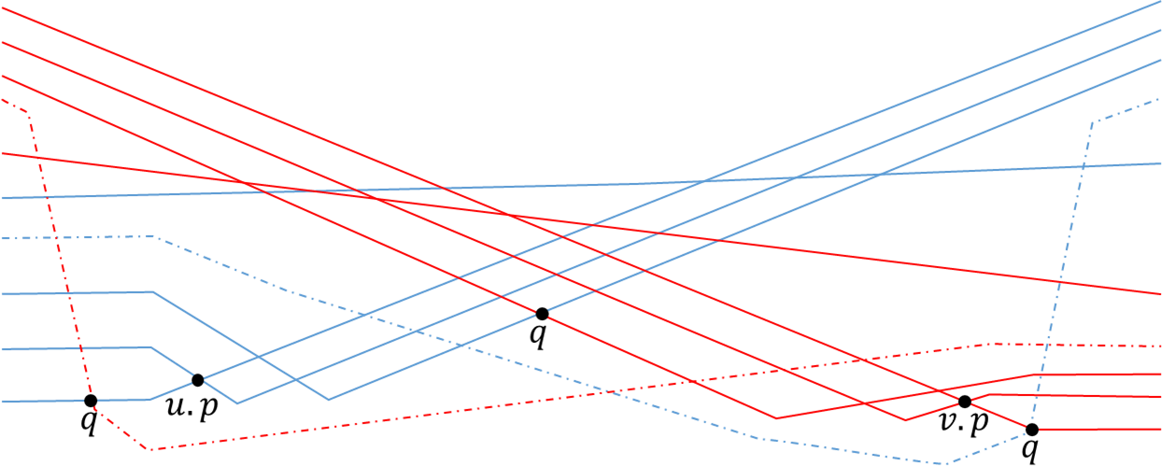
Dynamic Planar Lower Envelopes of Pseudolines
Key challenge:
find the intersection of two lower envelopes
Idea:
simultaneous binary search in both envelopes
Problem:
for pseudolines, local information is not always sufficient
Case 3: each pivot point is below the pivot envelope of the other
This is a problem!

Slide 17
Dynamic Planar Lower Envelopes of Pseudolines
Key challenge:
find the intersection of two lower envelopes
Idea:
for pseudolines, we postpone the decision (tentative binary search)
When we cannot decide, we progress in both trees, knowing that in at least one of them we made the correct step
We record the fact that either of the steps (at most one) may be erroneous, and will need to be retracted
Since at least one step is correct, we can use a charging argument to bound the total number of steps by O(log n)

Slide 18
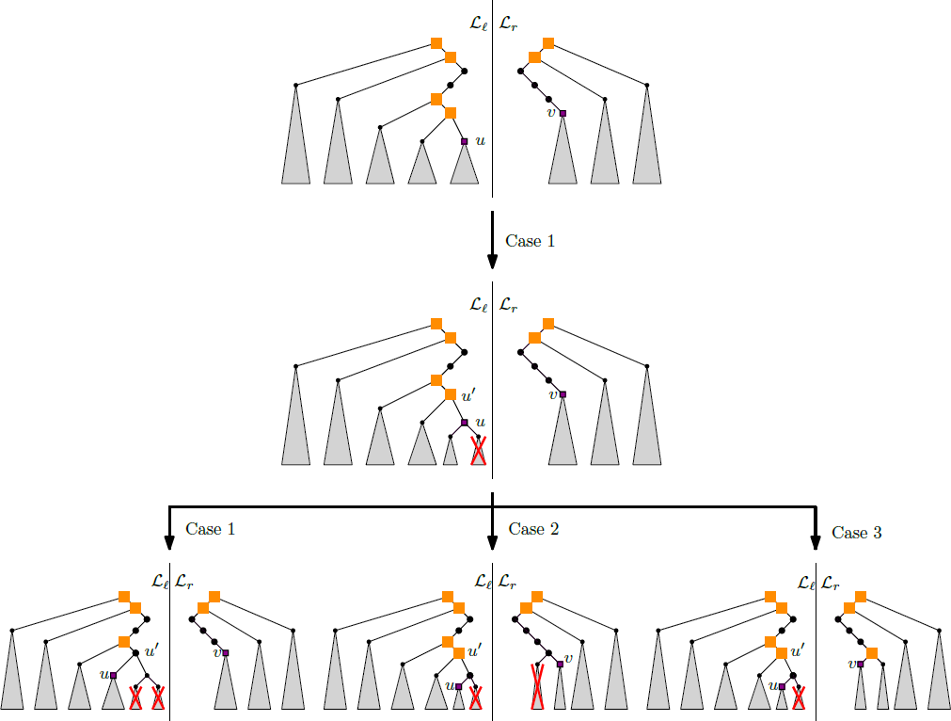
Dynamic Planar Lower Envelopes of Pseudolines

Slide 19
Dynamic Planar Lower Envelopes
Running time:
O(log n) for finding intersection
O(log² n) per operation
with Agarwal, Cohen, and Halperin
Open problems:
O(log^{2-ε} n) for finding number of vertices on lower envelope (also open for lines, offline setting?)
Do improvements also apply for pseudolines?
Good implementations?
Understand Brodal-Jacob 2001!

Slide 20
Dynamic Lower Envelopes in R³
Goal:
a fully dynamic data structure to support a lower envelope of planes
Operations:
insert:
insert a new plane
delete:
delete a plane
vertical ray shooting:
which plane appears on the lower envelope at a point (x, y)?

Slide 21
Dynamic Lower Envelopes in R³
Approach by Chan, 2010
Idea:
Bentley-Saxe: maintain O(log n) sets of growing sizes
exploit decomposable queries

Slide 22
Dynamic Lower Envelopes in R³
Approach by Chan, 2010
Idea:
Bentley-Saxe: maintain O(log n) sets of growing sizes
insertions rebuild parts of the structure

Slide 23
Dynamic Lower Envelopes in R³
Approach by Chan, 2010
Idea:
Bentley-Saxe: maintain O(log n) sets of growing sizes
lazy deletions: keep deleted planes in structure, mark them as deleted
deletion lookahead: reinsert planes before they get exposed

Slide 24
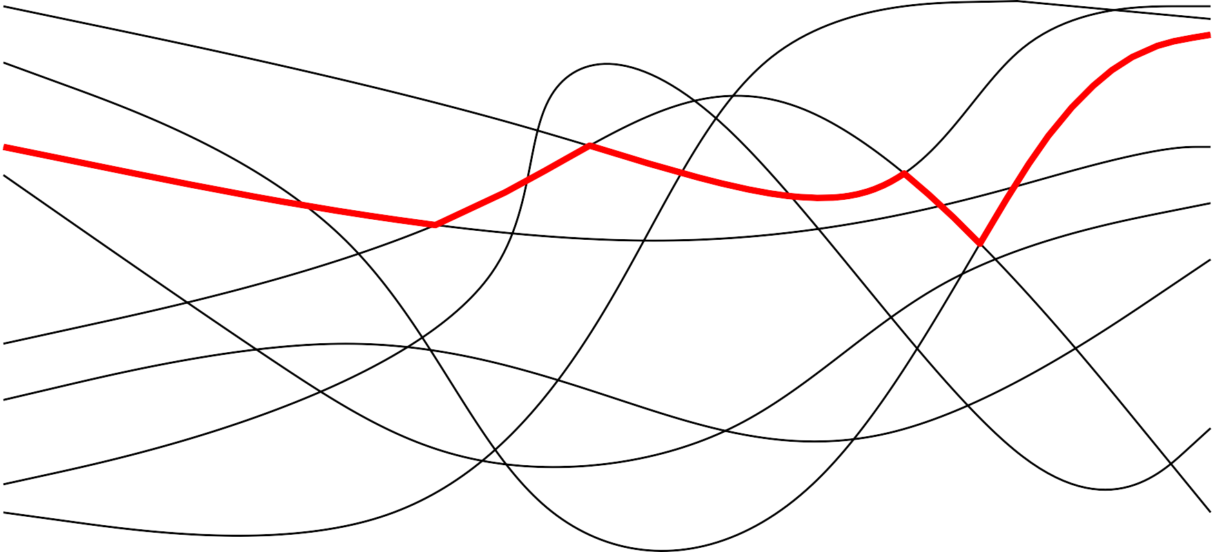
Dynamic Lower Envelopes in R³
Key challenge:
implement the deletion lookahead mechanism efficiently
Main tool:
shallow cuttings help us localize planes that may get exposed. Details are a bit subtle

Slide 25
Dynamic Lower Envelopes in R³
Key challenge:
implement the deletion lookahead mechanism efficiently
Since then:
improved log-factors [Chan 2019, Kaplan et al. 2017]
general surfaces [Kaplan et al. 2017, Liu 2019]
many applications [Kaplan et al. 2017, Baumann et al. 2019]
Open problems:
still better log-factors?
a general framework to make dynamic structures based on shallow cuttings?
deamortization?
making it practical?
special queries (window-sliding)?

Slide 26
Disk Graphs
n sites in the plane
each site p has an associated radius r_{p}
undirected
sites p, q are adjacent iff |pq| ≤ r_{p} + r_{q}

Slide 27
Dynamic Connectivity
dynamic graph: insert, delete, connected?

Slide 28
Dynamic Connectivity
dynamic graph: insert, delete, connected?
p
q
q

Slide 29
Dynamic Connectivity
general graphs: O(log² n) update, O(log n/loglog n) query [Holm et al.]
planar graphs: O(log n) update, O(log n) query [Eppstein et al.]
unit disk graphs?
p
q

Slide 30
Dynamic Connectivity in Unit Disk Graphs
dynamic set P ⊂ R², |P| = n

Slide 31
Dynamic Connectivity in Unit Disk Graphs
dynamic set P ⊂ R², |P| = n
Chan et al: O(log¹⁰ n) updates, O(log n/loglog n) queries
UDG
EMST
update edges
queries
Holm et al.

Slide 32
Dynamic Connectivity in Unit Disk Graphs
dynamic set P ⊂ R², |P| = n
Chan et al: O(log¹⁰ n) updates, O(log n/loglog n) queries
O(log²n)
UDG
EMST
DBCP
update edges
Agarwal et al.
queries
Holm et al.
B ⊂ R²
A ⊂ R²

Slide 33
Dynamic Connectivity in Unit Disk Graphs
dynamic set P ⊂ R², |P| = n
Chan et al: O(log¹⁰ n) updates, O(log n/loglog n) queries
Chan et al: O(log⁹ n) updates, O(log n/loglog n) queries
Chan et al: O(log⁸ n) updates, O(log n/loglog n) queries
O(log²n)
O(log²n)
UDG
EMST
DBCP
DNN
update edges
Agarwal et al.
Eppstein
queries
Chan: O(log⁶ n)
Holm et al.
Kaplan et al.: O(log⁵ n)
Chan: O(log⁴ n)
P ⊂ R²

Slide 34
Dynamic Connectivity in Unit Disk Graphs
dynamic set P ⊂ R², |P| = n
Chan et al: O(log⁶ n) updates, O(log n/loglog n) queries
O(log²n)
UDG
EMST
DBCP
update edges
Agarwal et al.
queries
Chan: O(log⁴ n)
Holm et al.
B ⊂ R²
A ⊂ R²

Slide 35
The Grid Graph
grid of diameter 1

Slide 36
The Grid Graph
connect nonempty adjacent cells

Slide 37
The Grid Graph
connect nonempty adjacent cells

Slide 38
The Grid Graph
consider neighborhoods

Slide 39
Dynamic Connectivity in Unit Disk Graphs
update time: O(log⁴ n)
update time: O(log⁶ n)
O(1)
UDG
Grid
DBCP
update edges
queries
Chan: O(log⁴ n)
Holm et al.
A ⊂ R²
≤ 1?
B ⊂ R²

Slide 40
Dynamic Connectivity in Unit Disk Graphs
update time: O(log⁴ n)
O(1)
UDG
Grid
MBM
update edges
queries
Holm et al.
matching M
M ≠ ∅

Slide 41
Dynamic Connectivity in Unit Disk Graphs
update time: O(log⁴ n)
O(1)
O(1)
UDG
Grid
MBM
DNN
update edges
queries
Chan: O(log⁴ n)
Holm et al.
matching M
M ≠ ∅
>1
≤1

Slide 42
Dynamic Connectivity in Unit Disk Graphs
update time: O(log⁴ n)
O(1)
O(1)
UDG
Grid
MBM
DNN
update edges
queries
Chan: O(log⁴ n)
Holm et al.
matching M
M ≠ ∅
≤1

Slide 43
Dynamic Connectivity in Unit Disk Graphs
update time: O(log² n)
Kaplan et al.,
Agarwal et al.: O(log n log log n)
update time: O(log⁴ n)
O(1)
O(1)
UDG
Grid
MBM
DLE
update edges
queries
Holm et al.
matching M
M ≠ ∅

Slide 44
Dynamic Connectivity in Unit Disk Graphs
update time: O(log² n)
Kaplan et al.,
Agarwal et al.: O(log n log log n)
O(1)
O(1)
UDG
Grid
MBM
DLE
update edges
queries
Holm et al.
Thm 1 [w/ HK, LR, PS]: Can maintain UD(P) with O(log² n) updates and O(log n/log log n) queries.

Slide 45
Dynamic Connectivity in Unit Disk Graphs
update time: O(log² n)
O(1)
O(1)
UDG
Grid
MBM
DLE
update edges
queries
Eppstein et al.
make planar
Thm 1 [w/ HK, LR, PS]: Can maintain UD(P) with O(log² n) updates and O(log n/log log n) queries.
Thm 2 [w/ HK, LR, PS]: Can maintain UD(P) with O(log n loglog n) updates and O(log n) queries.

Slide 46
Dynamic Connectivity in Unit Disk Graphs
Since then:
improved results for general radii [Chan-Huang 2024, Bauman et al. 2017]
many variants
Open problems:
lower bounds?
faster algorithms in special cases (semidynamic, offline)?
simpler approach?
making it practical?
subgraph connectivity?
dynamic shortest paths, etc?

Slide 47
Conclusion
Not covered:
disk graphs with dynamic radii
dynamic algorithms for shape matching (e.g., Frechet distance)
dynamic algorithms for geometric set cover, hitting set, etc.
Questions?

